Slide 1
Team 4: Thea’s Pantry
Our Team: Eli Rivera-Hughes, Conner Moniz, Kaylene Noel, Ryan Karanja, & Shamarah Ramirez

Slide 2
Our Team Working Agreement
Team Experience:
Communication (discord)
Streamline collaboration
Don't be afraid to ask questions
Understanding roles and responsibilities
Time management
Divide work equally and fairly
All opinions are heard
Health Signals:
Checking in regularly to make sure everyone is on the same page
If not able to work, communicate with the team and work on a solution
Review each other's work
Rotate peer reviewers
Accountability:
If you make a mistake, make sure it is known and get help to fix it
Don't be afraid to own up to a mistake
To address the mistake, be direct but respectful. Don't take it personal
Psychological Safety:
If there is an issue, address it constructively
Don't shut down another person's opinion
Speak up when you want/have to
Active listening
Notes:
Kaylene

Slide 3
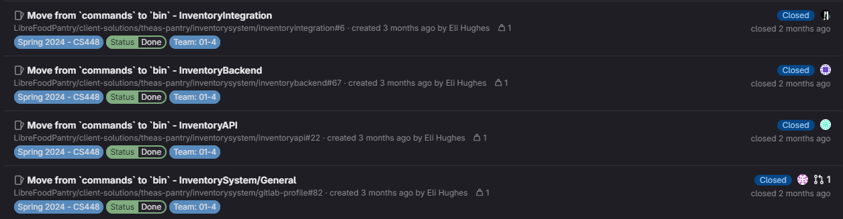
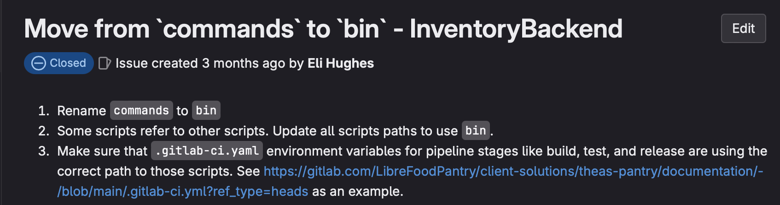
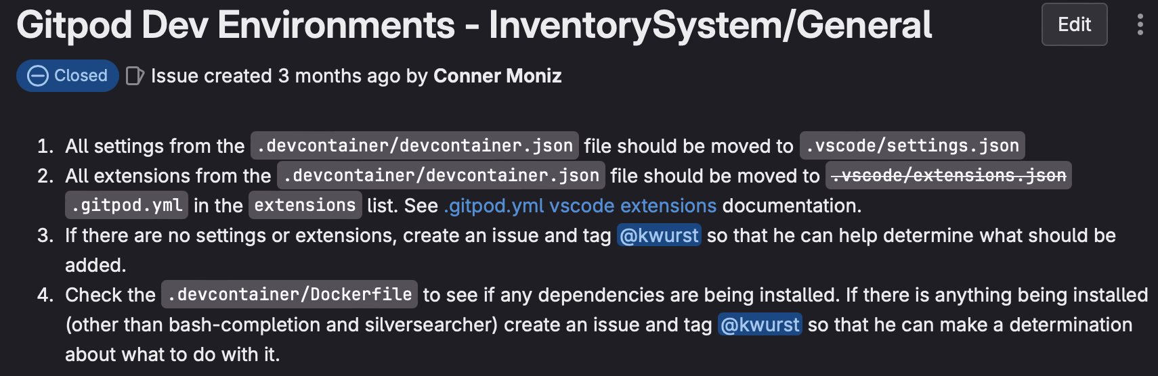
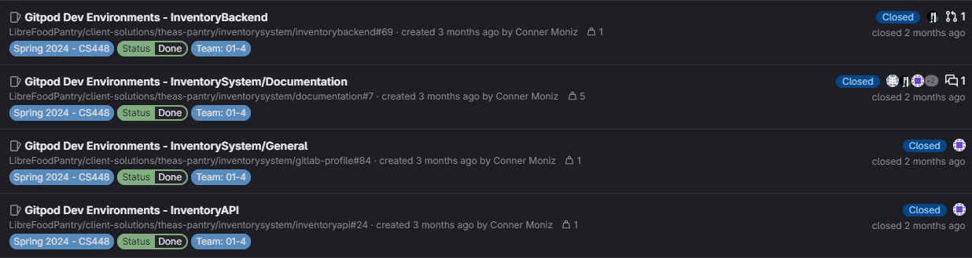
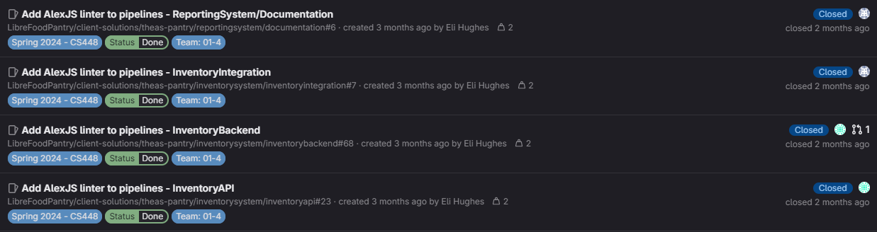
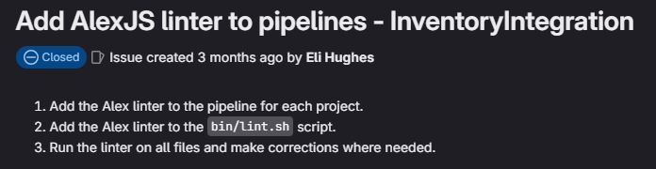
Sprint #1
Notes:
Ryan does Intro, Conner, Eli

Slide 4
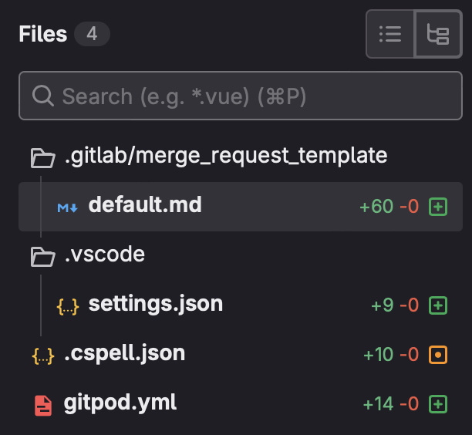
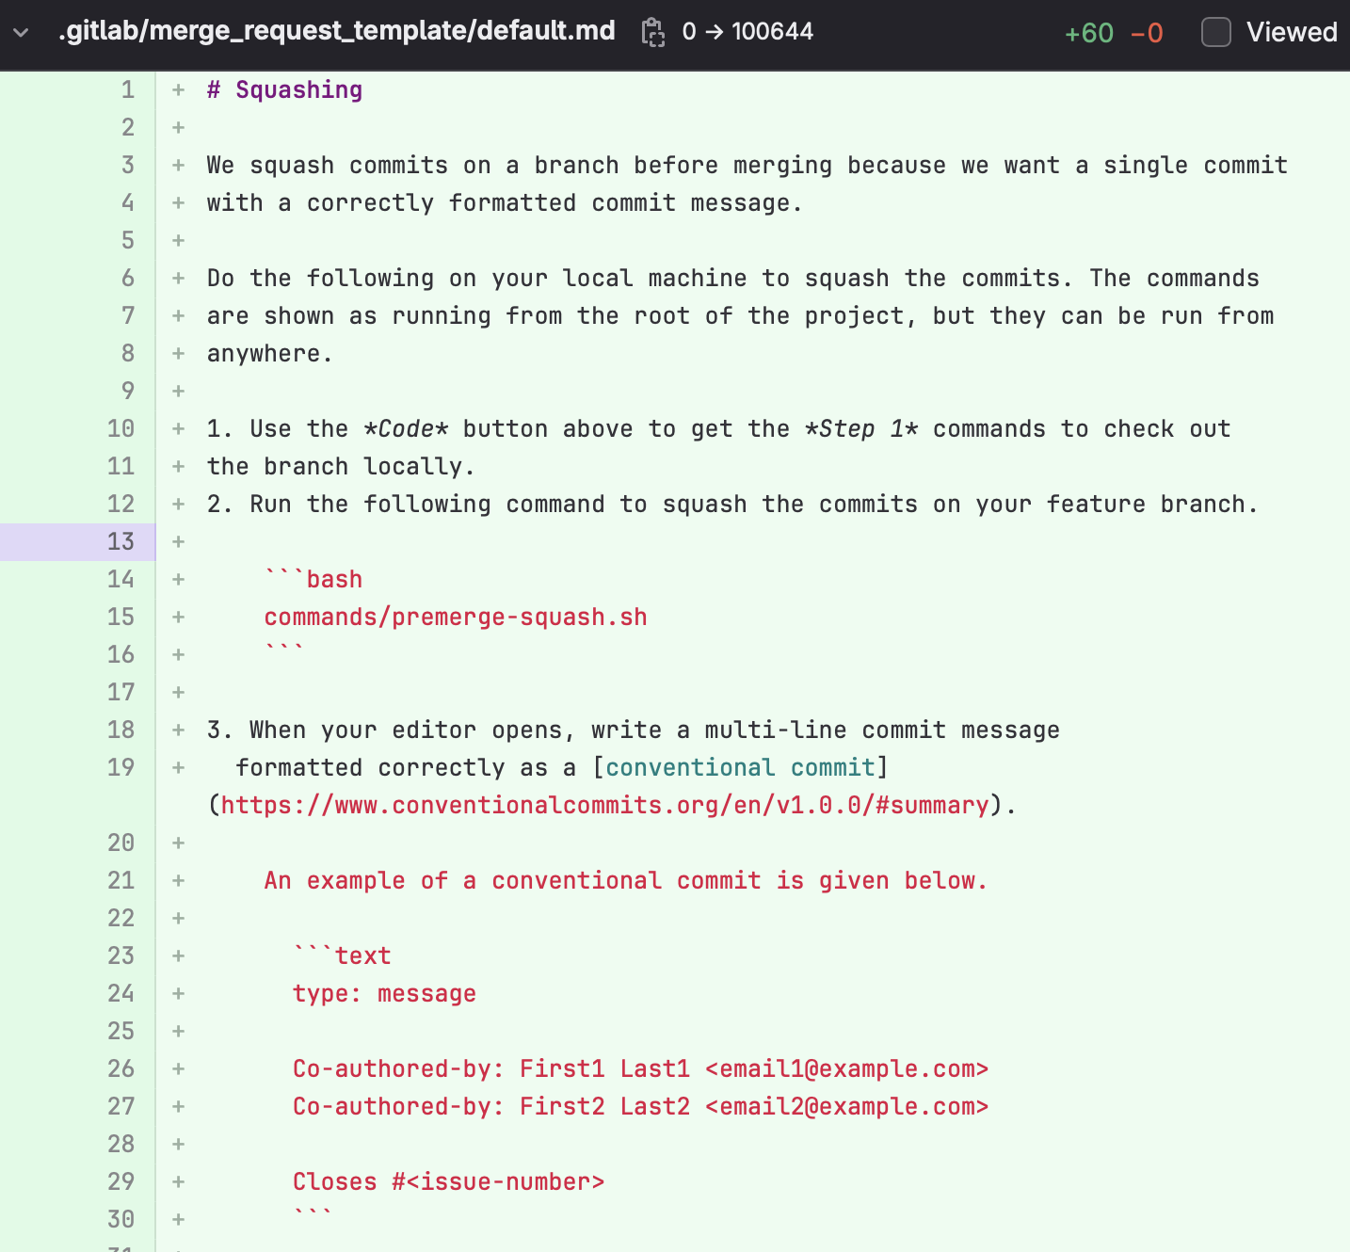
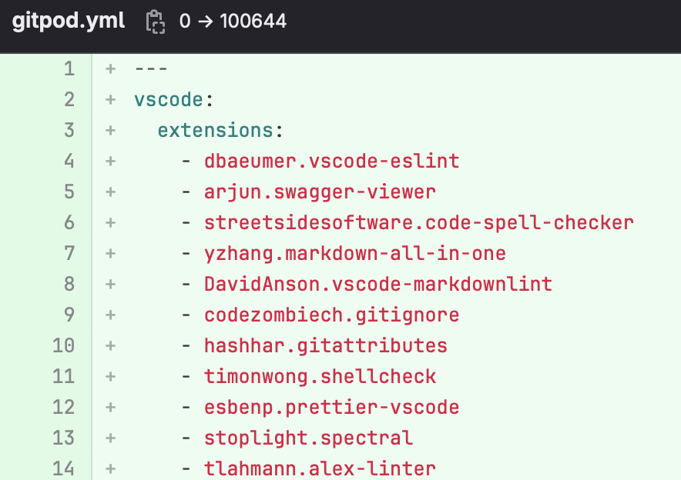
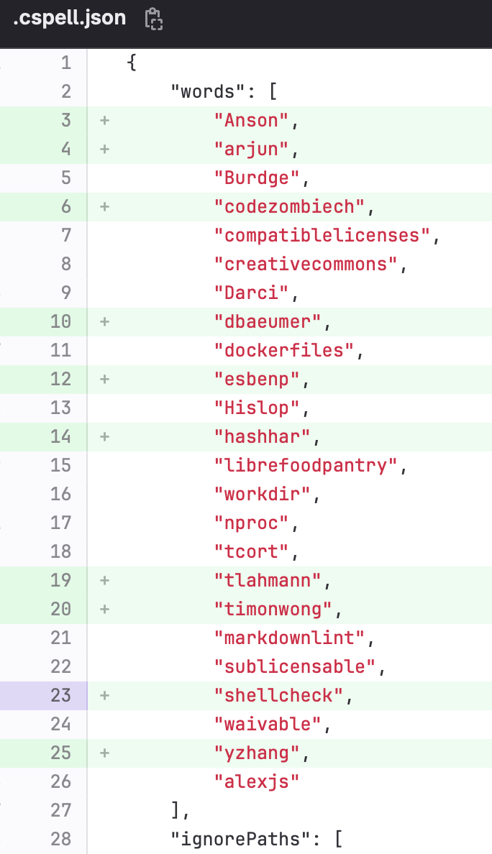
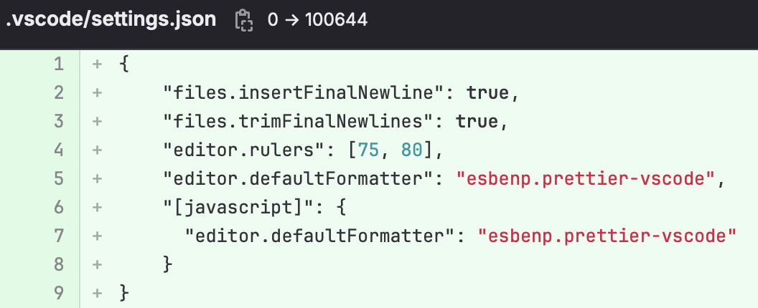
Gitpod Dev Environment
(InventorySystem/General)
Notes:
Conner’s Slide

Slide 5
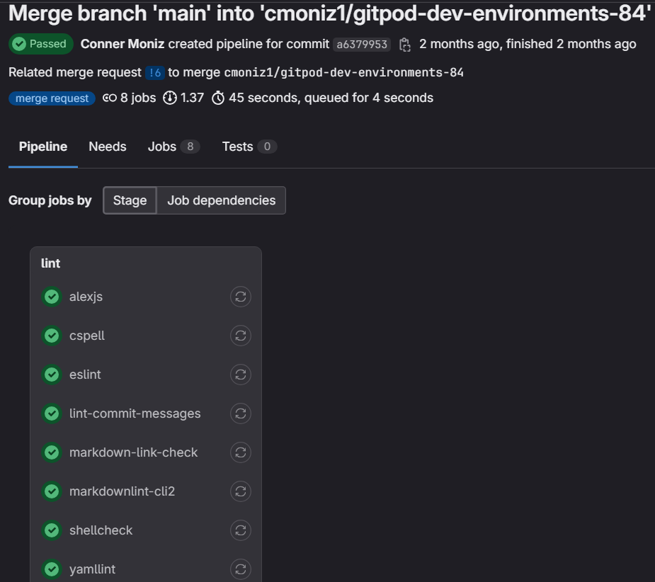

Slide 6
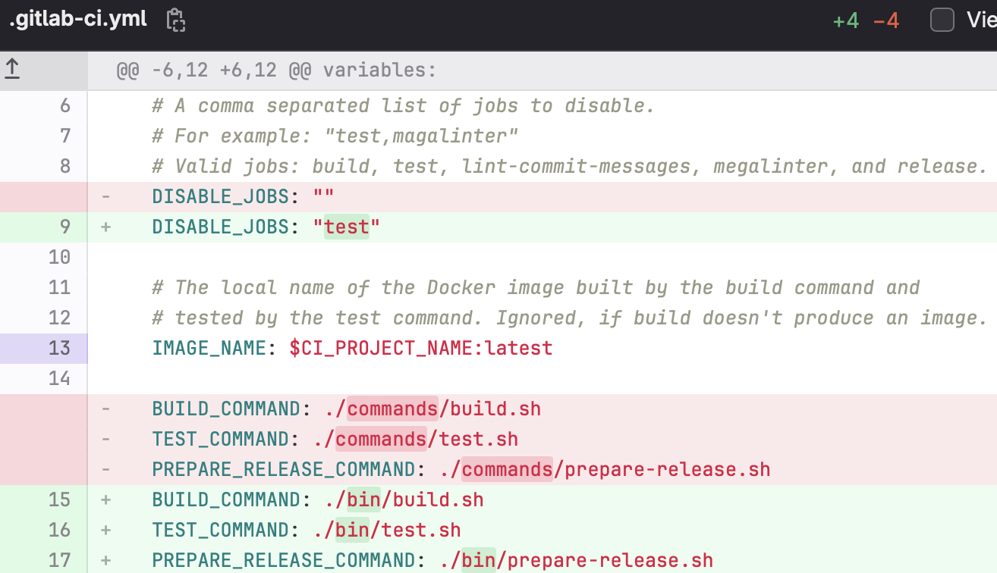
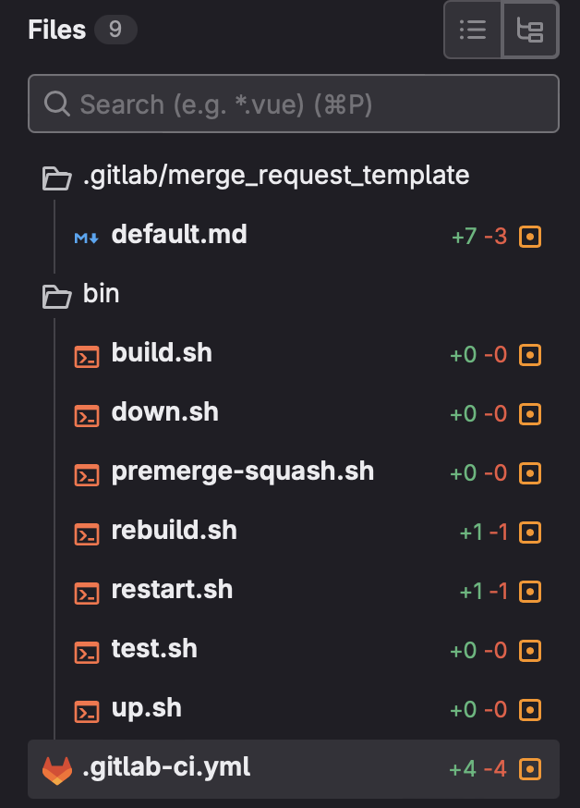
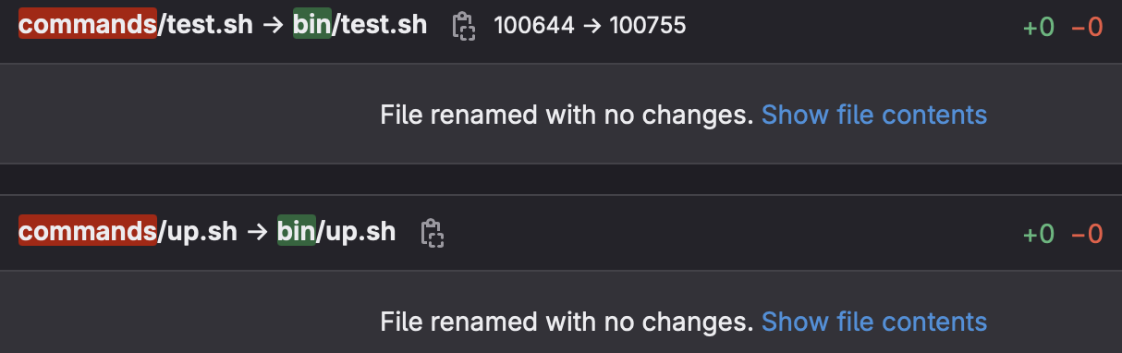
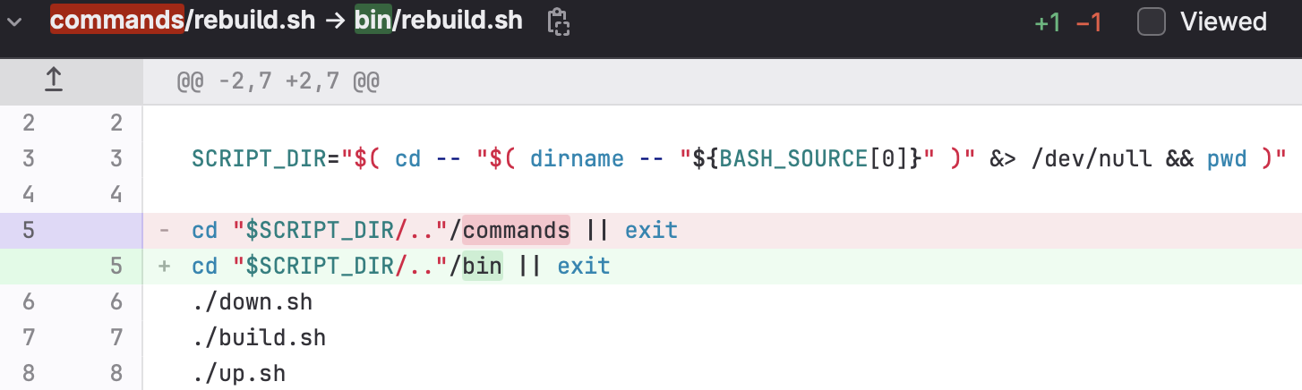
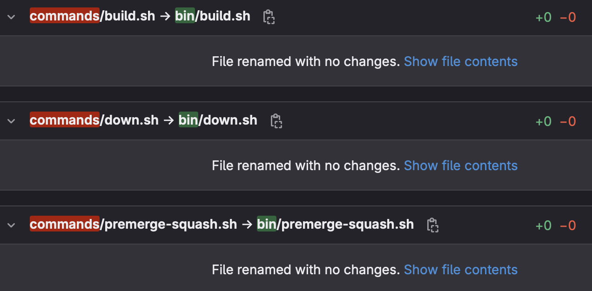
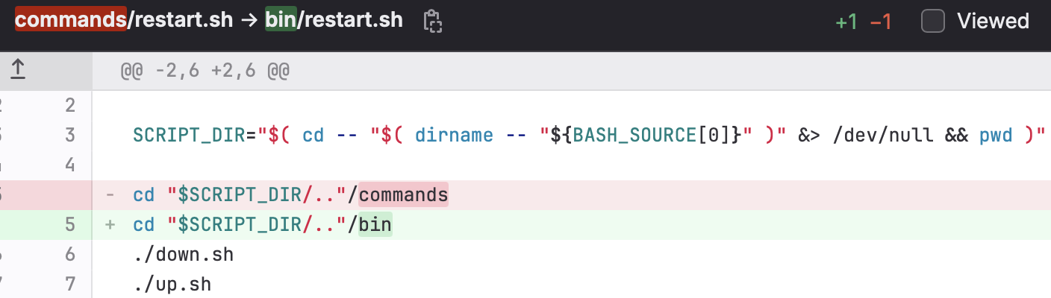
Move From ‘commands’ to ‘bin’
(InventoryBackend)
Notes:
Ryan’s Slide

Slide 7
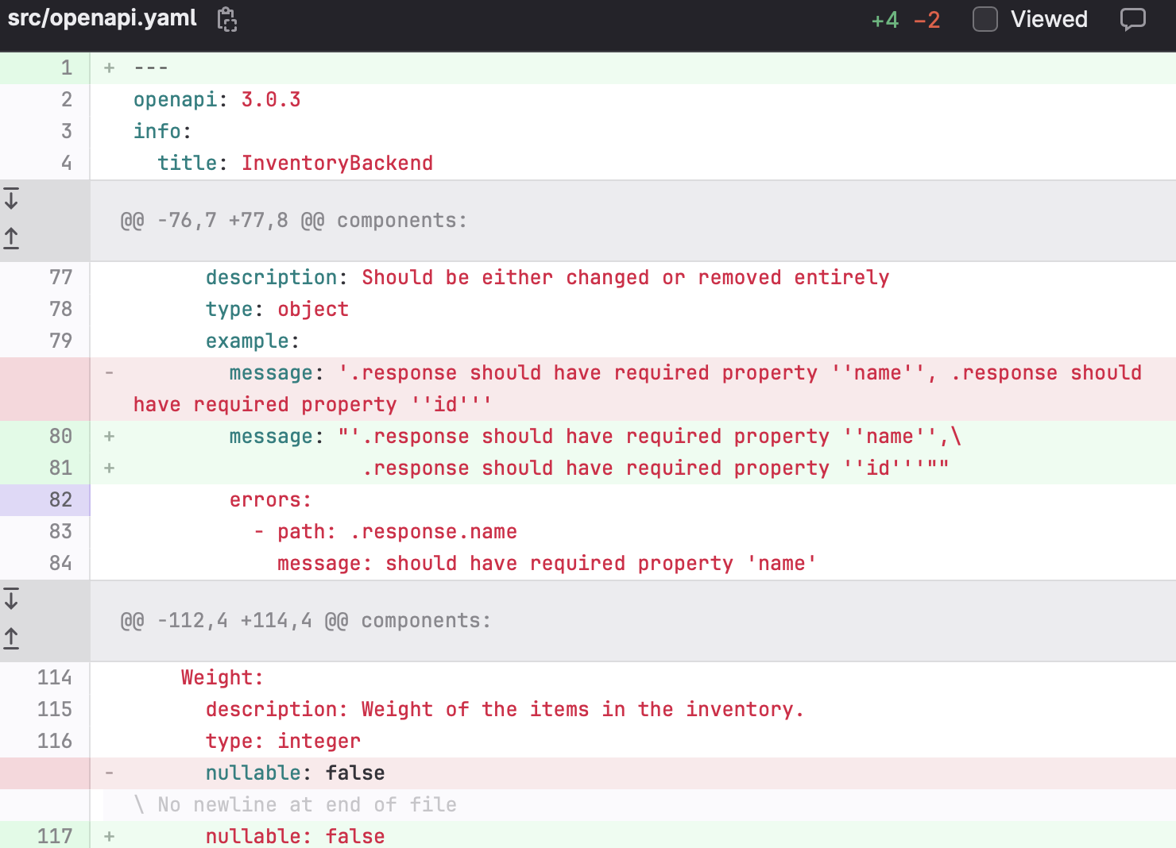
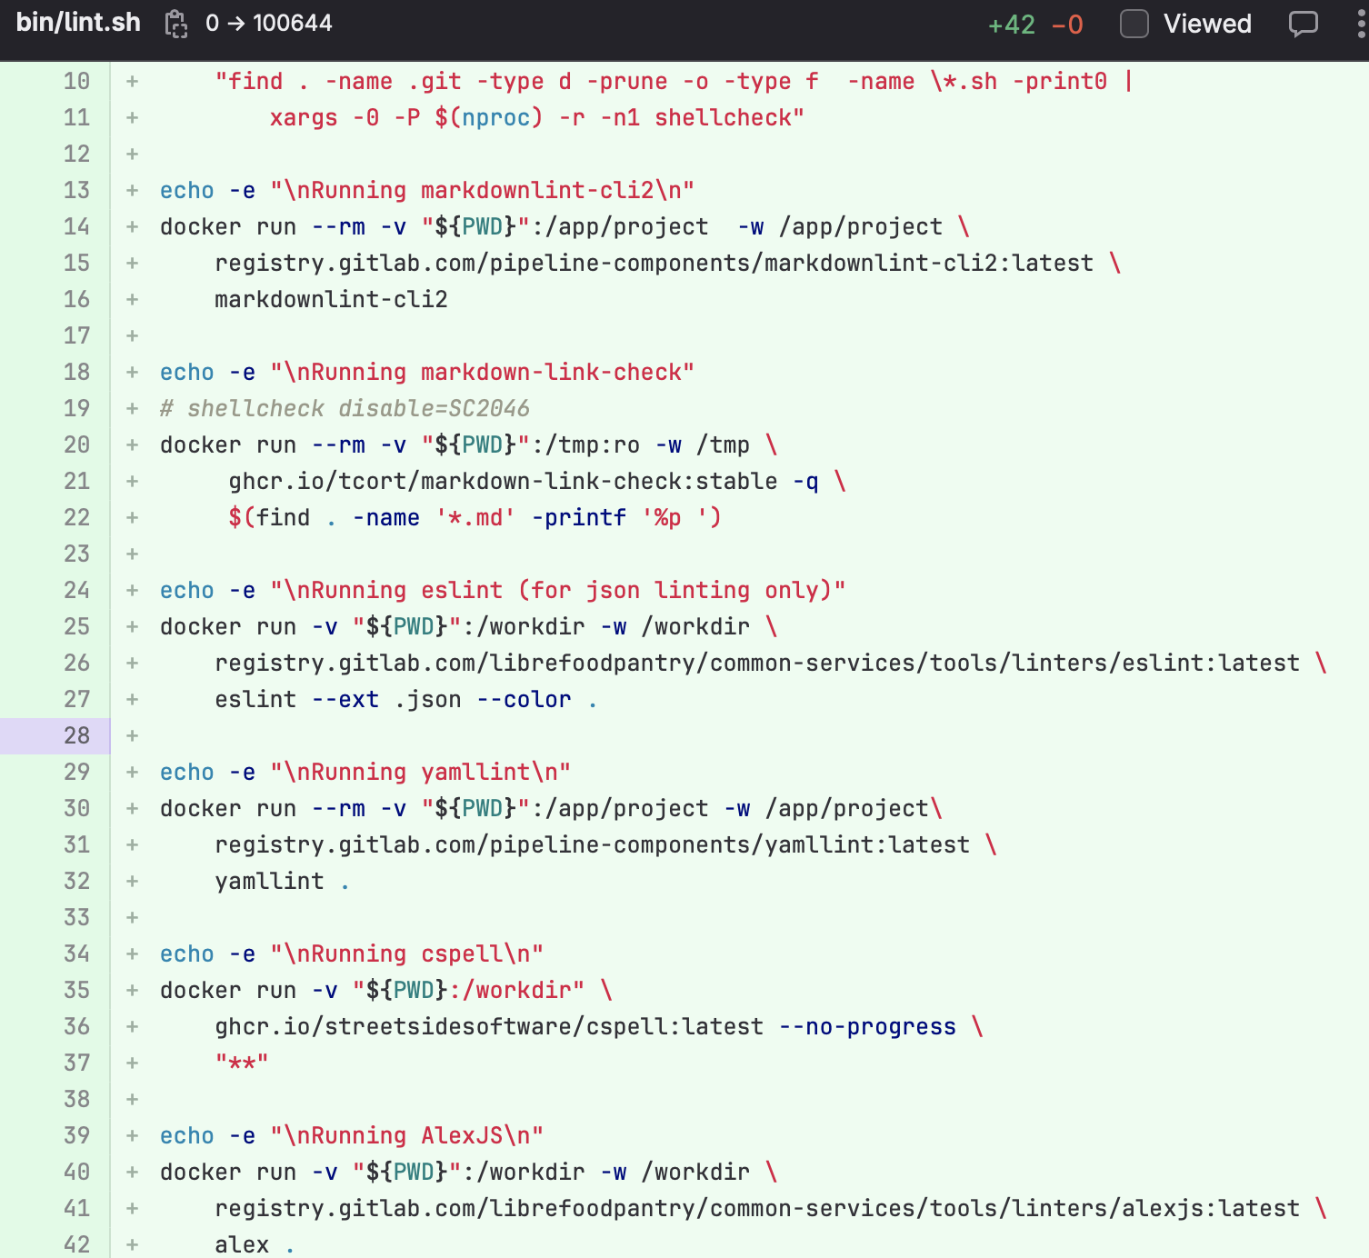
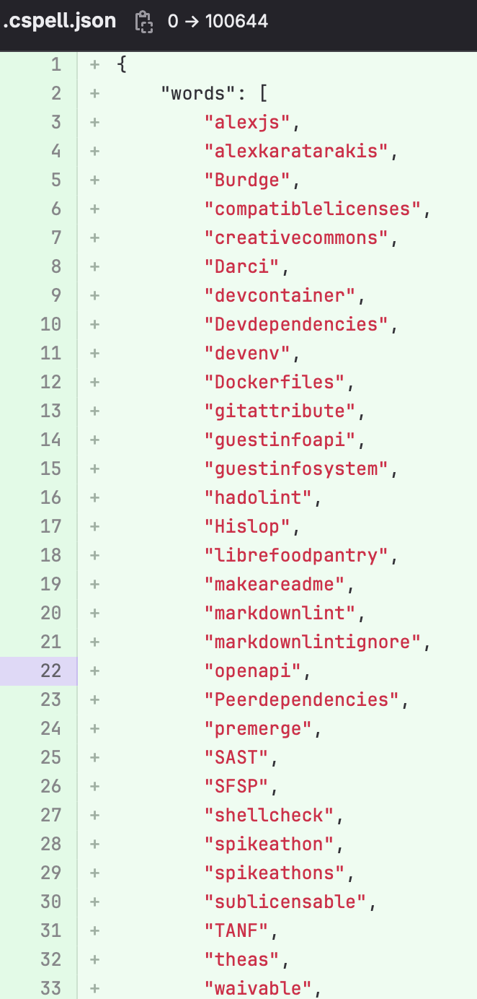
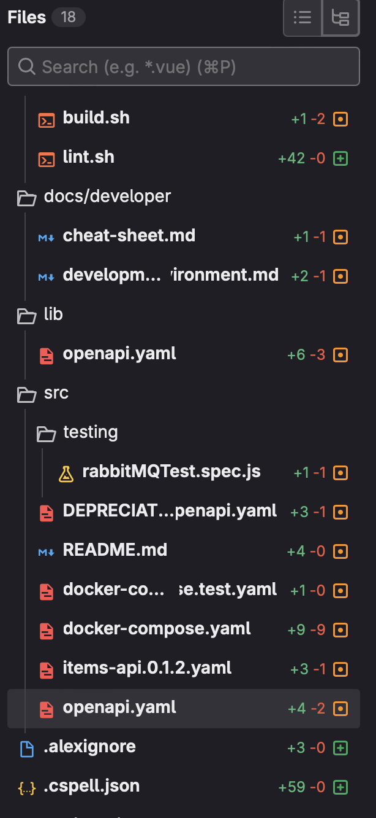
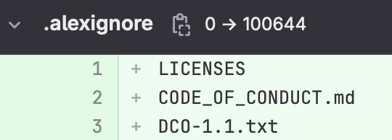
Add AlexJS Linter to Pipelines
(InventoryAPI)
Notes:
Eli

Slide 8
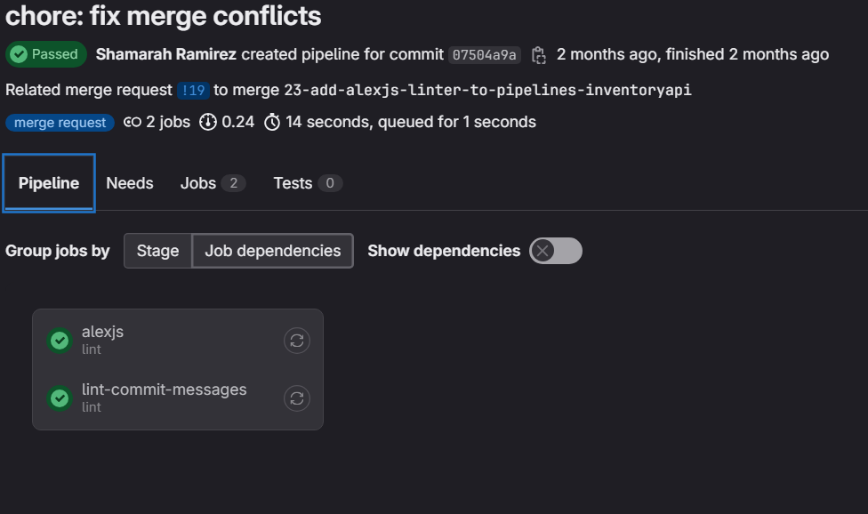

Slide 9
What went well?
We finished our first sprint achieving our goal of completing >75% of our issues (20 out of 25 points)
Actively listening to each others ideas and comments, not leaving anybody out
Understood our roles and responsibilities, made sure to ask questions if needed
Notes:
Shamarah

Slide 10
Where to improve?
Learning more in regards to Gitpod and GitLab.
Time Management.
Communicating and keeping in touch with the rest of the team.
Assigning equal amount of work to each member of the team.
Issue review process among team members and issues.
Notes:
Kaylene

Slide 11
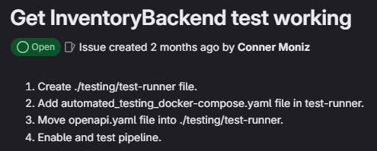
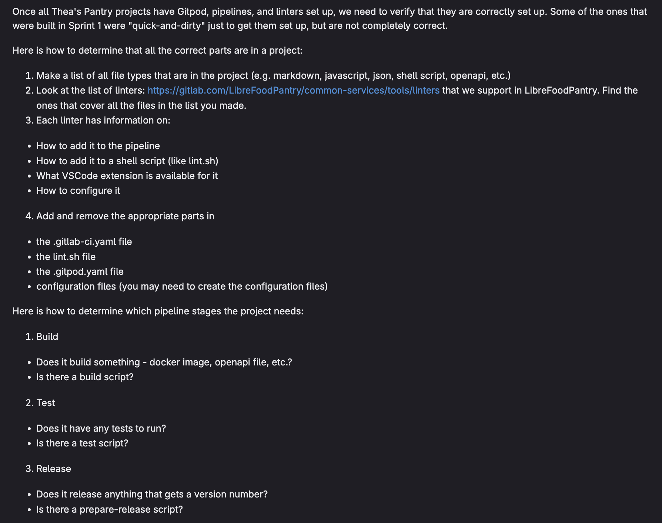
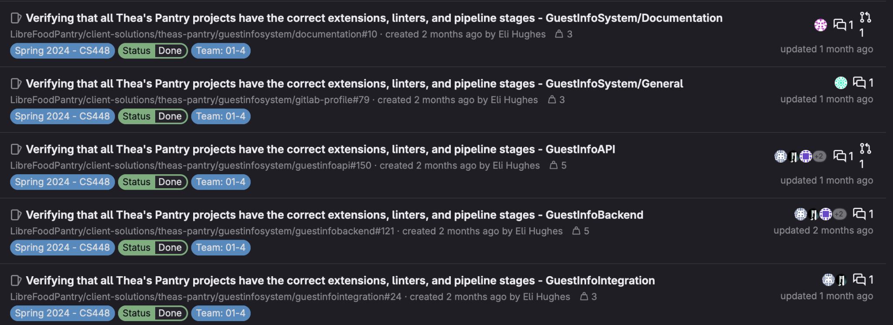
Sprint #2
Notes:
Kaylene

Slide 12
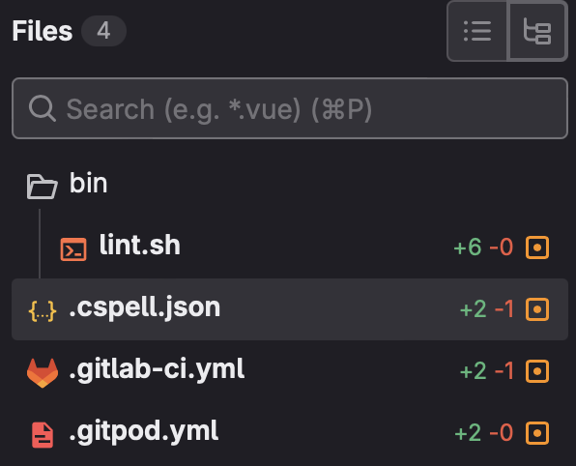
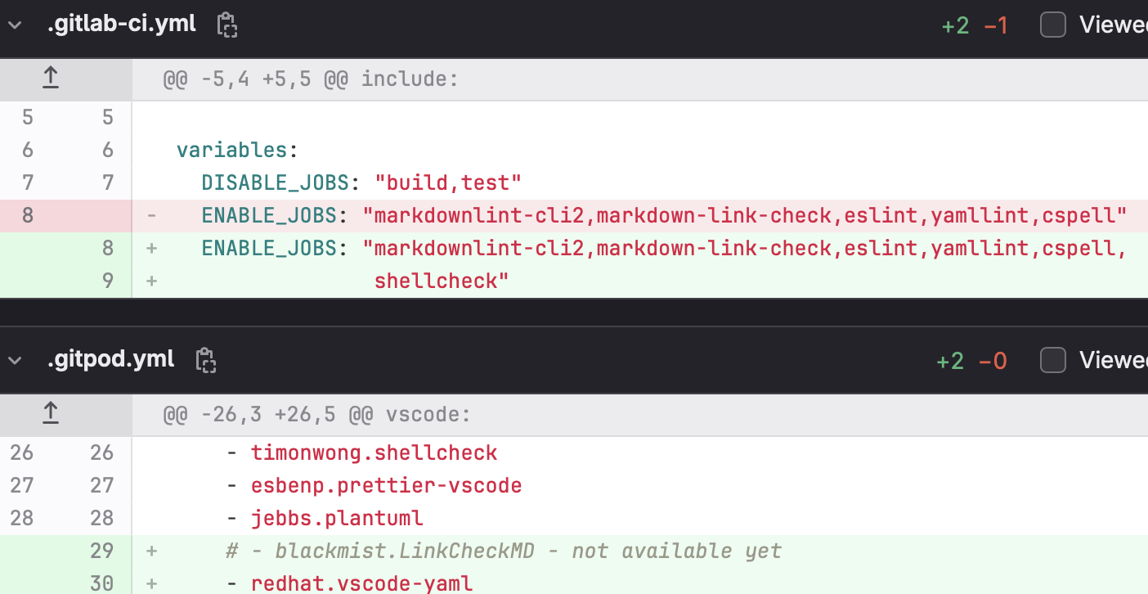
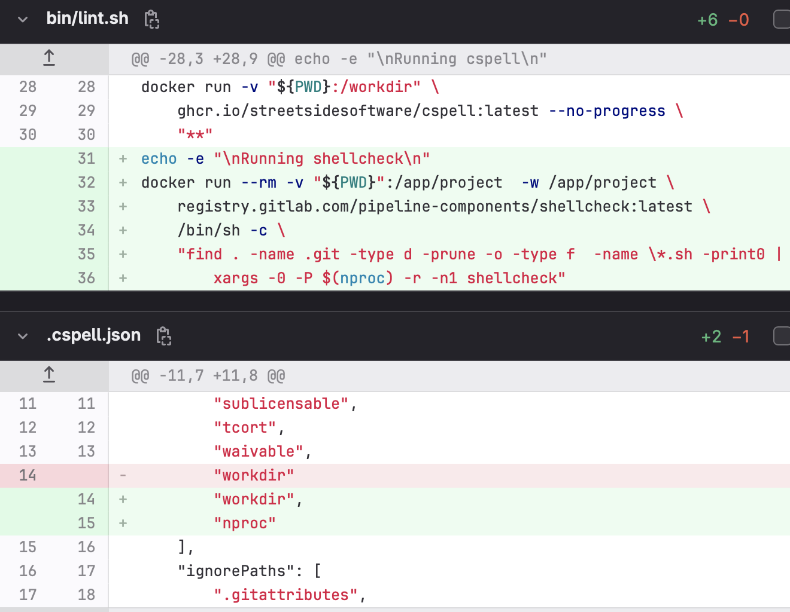
Verifying Correct Linters, Extensions, and Pipelines
(GuestInfoSystem/General)
Notes:
Shamarah

Slide 13
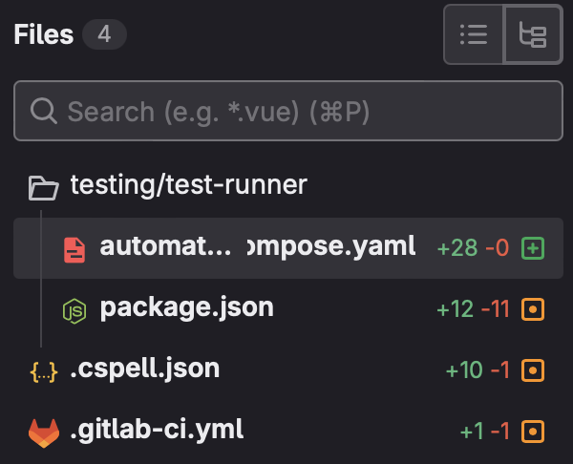
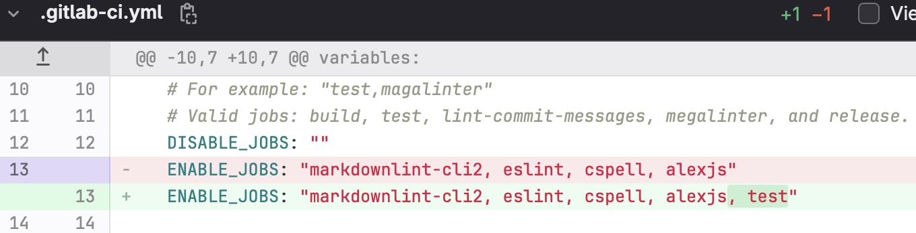
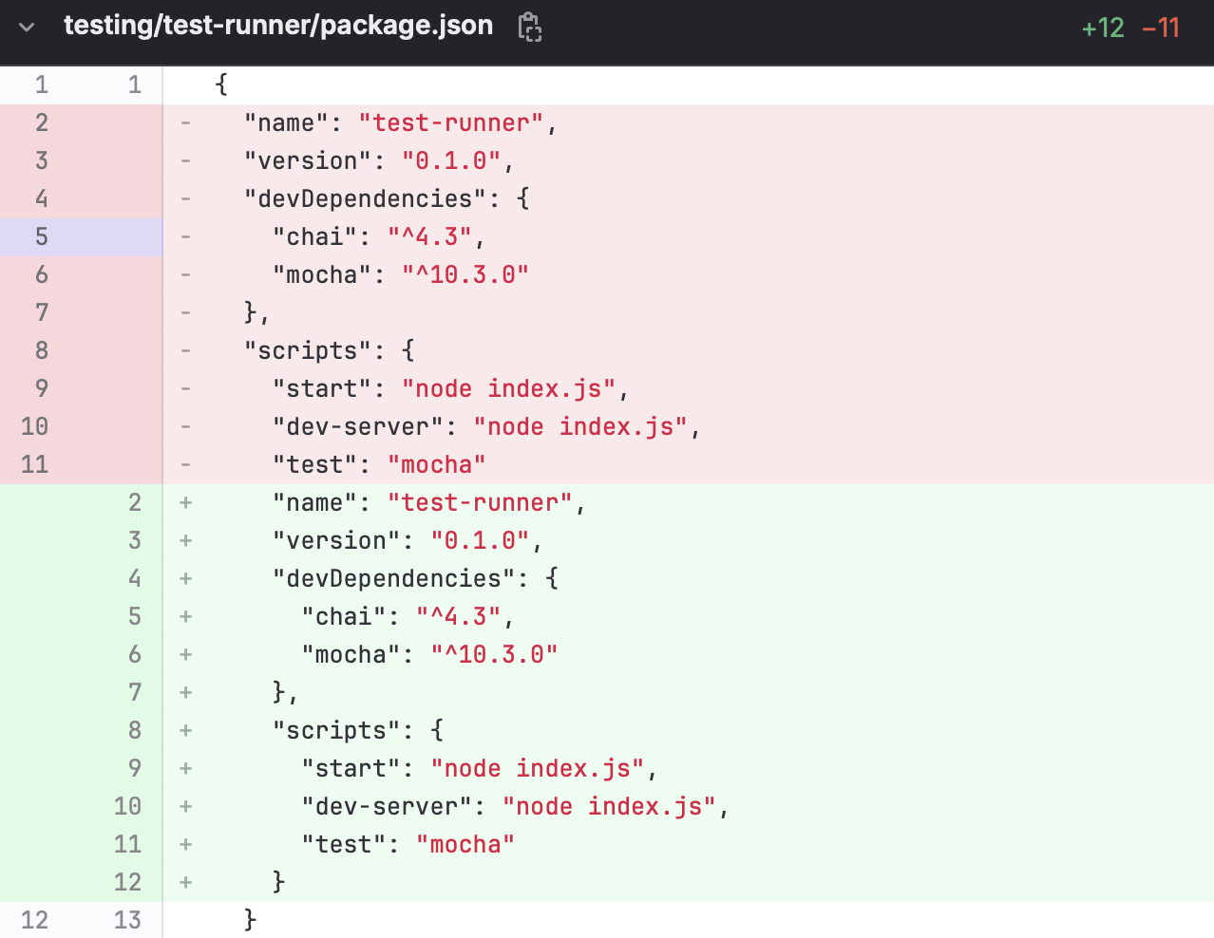
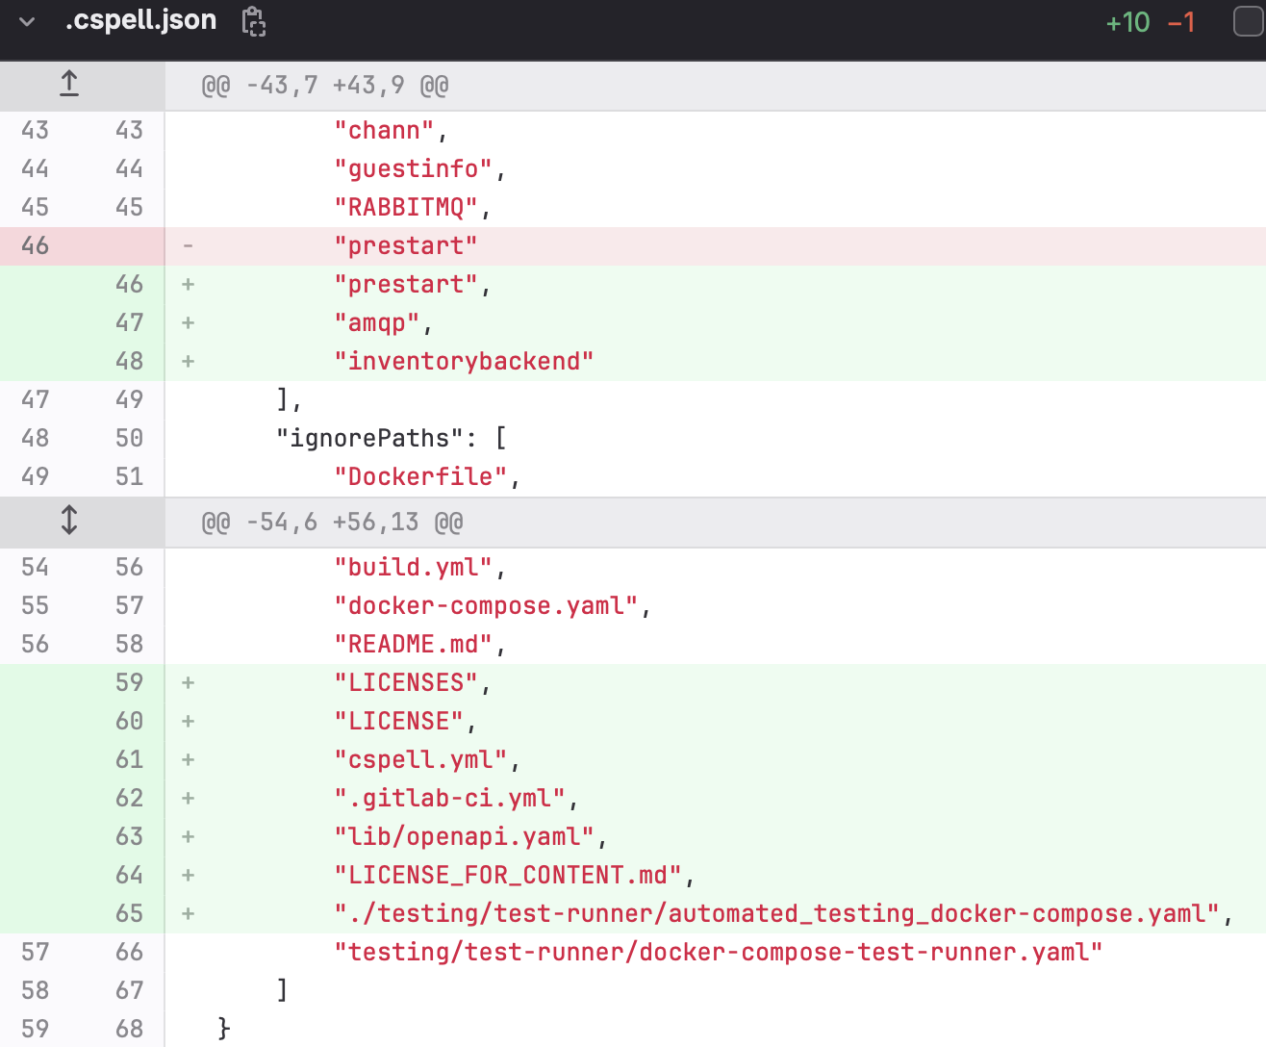
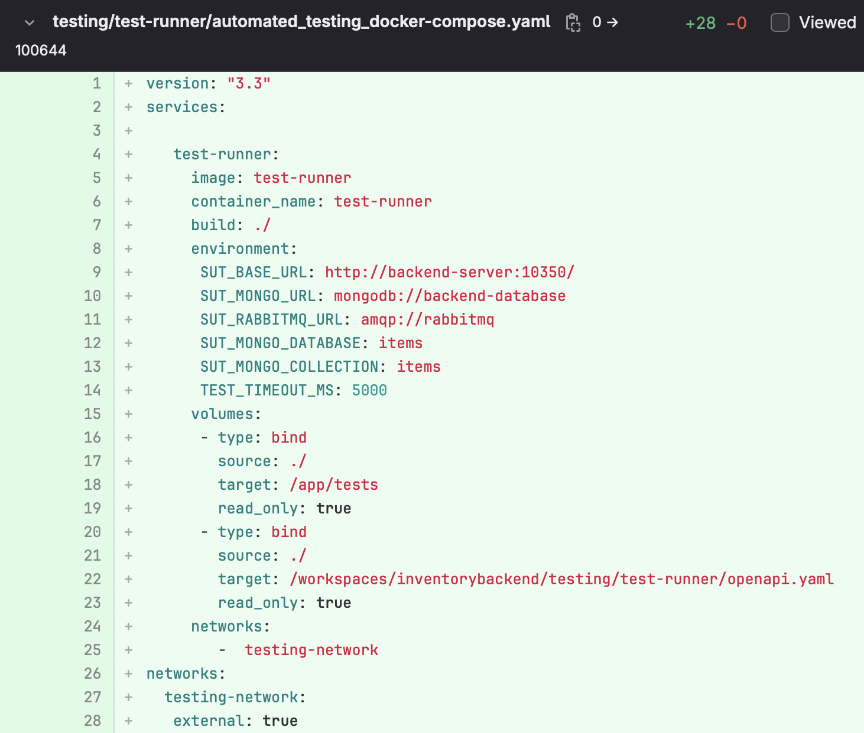
Get Inventory Backend Test Working
Notes:
Conner

Slide 14
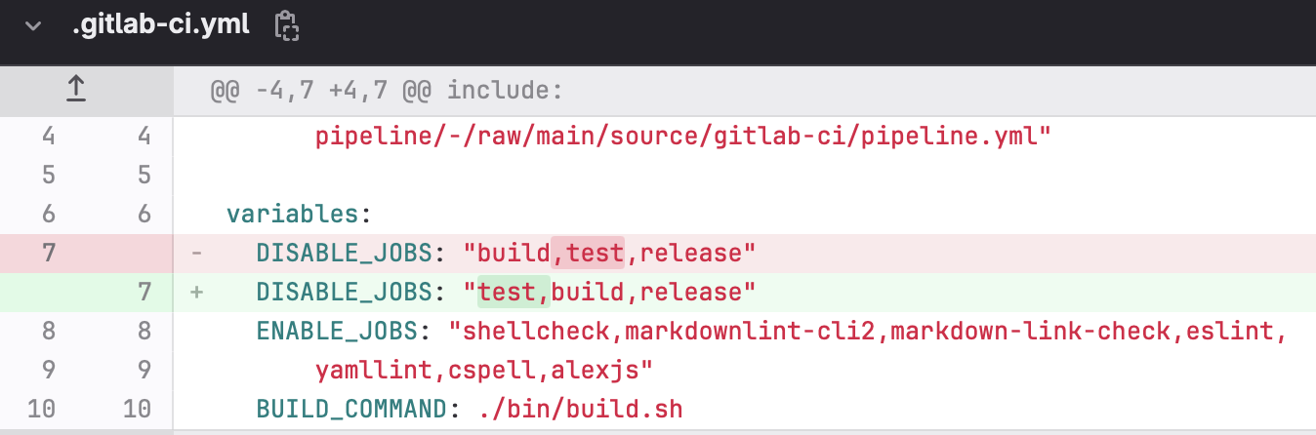
Get InventorySystemGeneral Test and Build Working
Notes:
Kaylene

Slide 15
What went well?
We all contributed equally to the issues over the sprint
We improved our reviewing methods for the sprint
Improved communication and workflow processes.
Managed our time very well
Notes:
Eli

Slide 16
Where to improve?
Making sure to review issues in Needs Review
Adding more comments to our merge requests
Making sure that another team isn’t working on a same issue
Notes:
Ryan

Slide 17
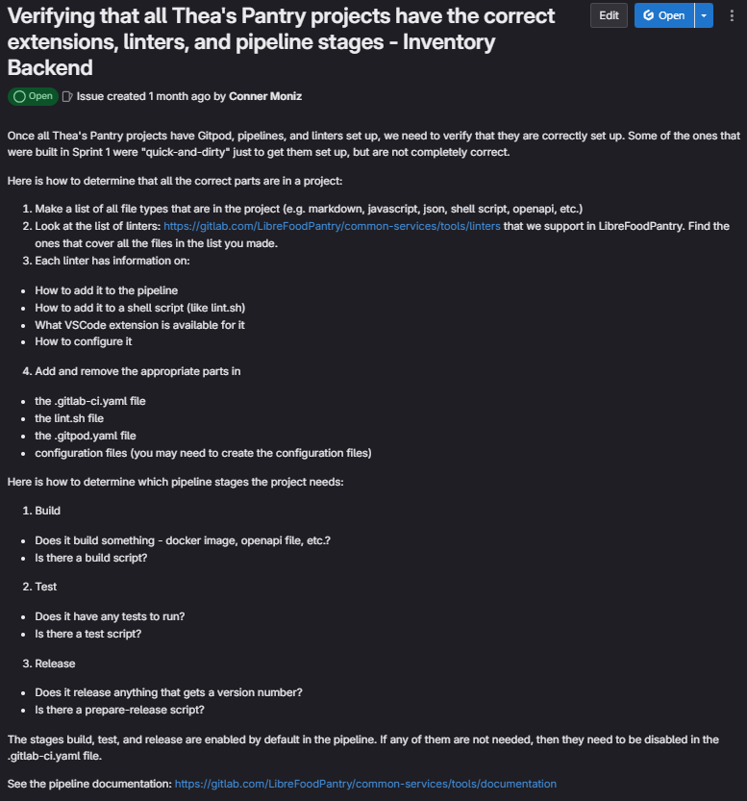
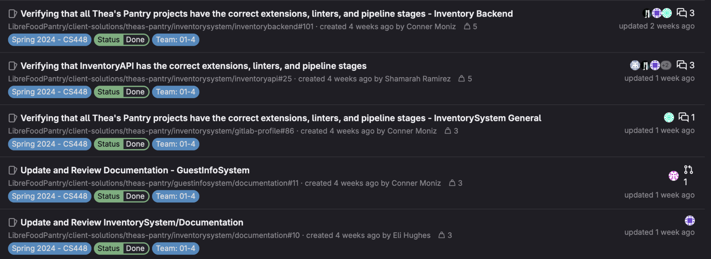
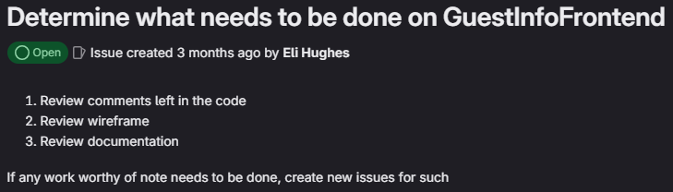
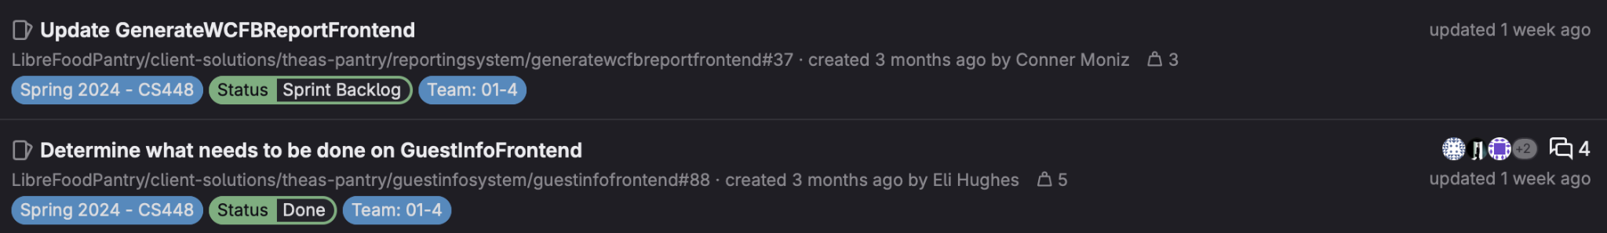
Sprint #3
Notes:
Conner, Eli

Slide 18
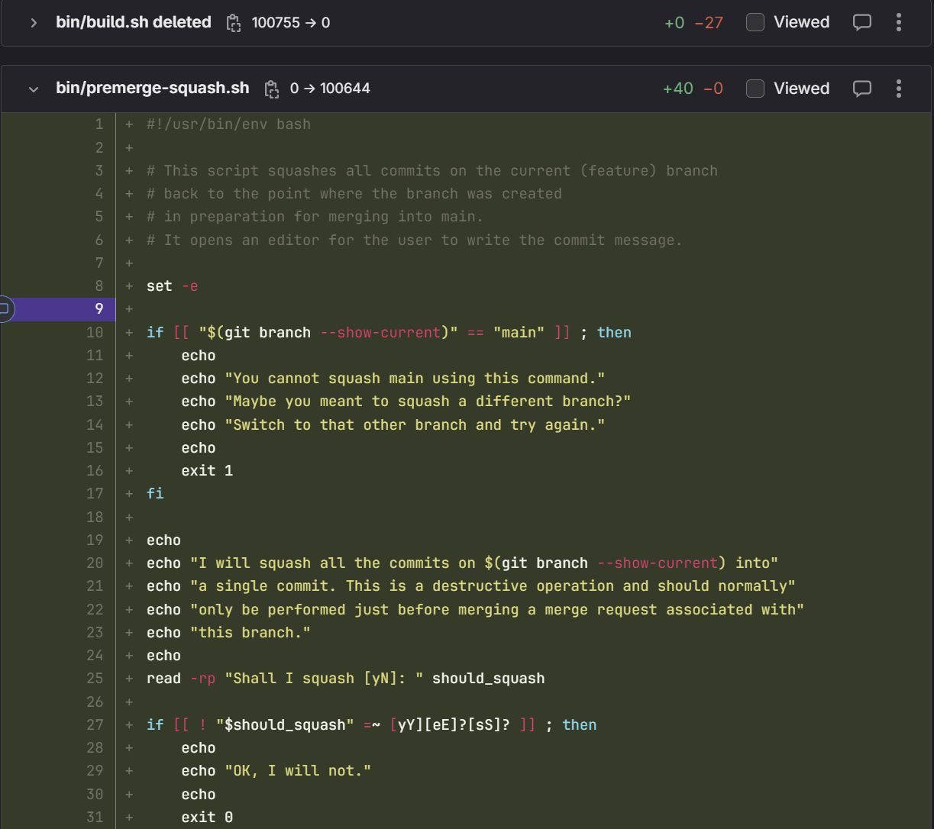
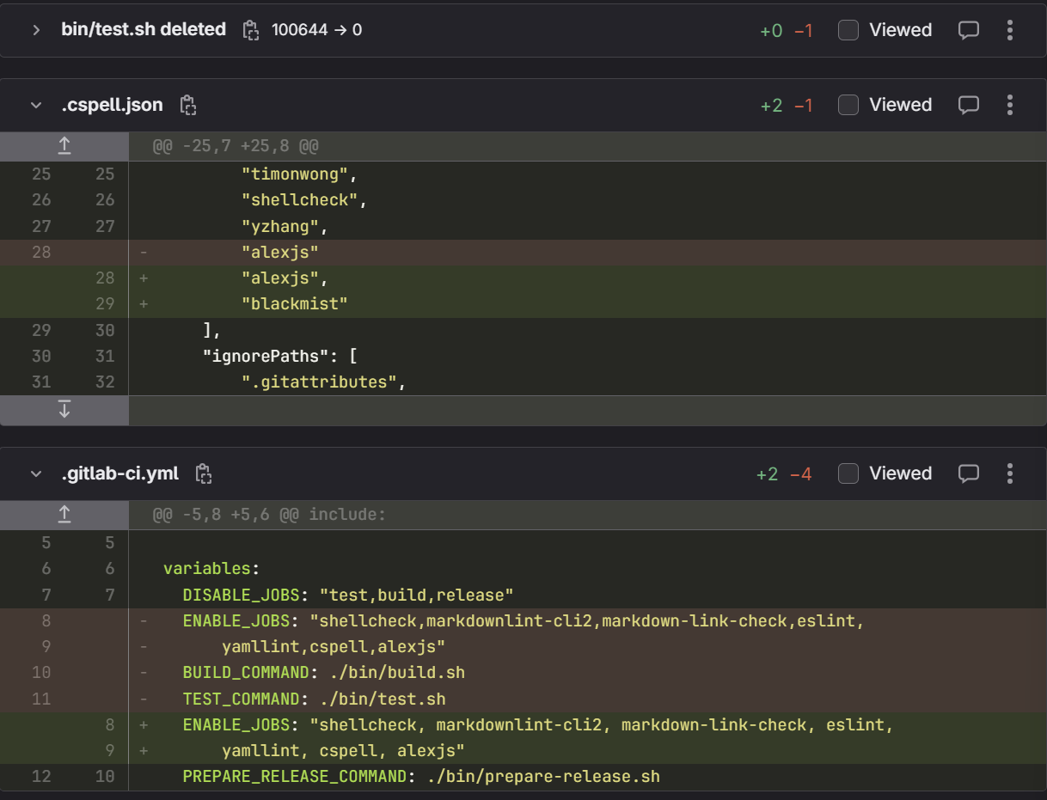
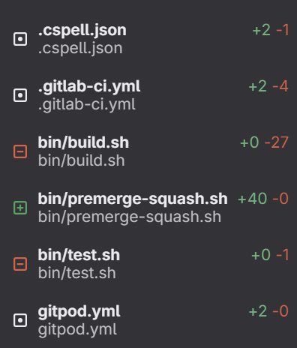
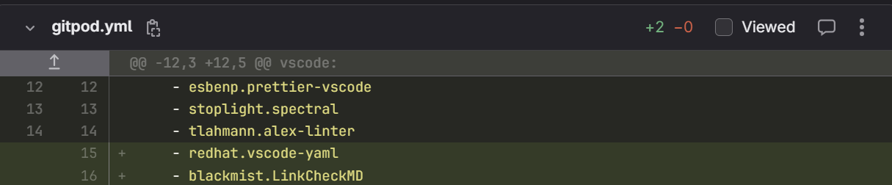
Verifying Correct Linters, Extensions, and Pipelines
(InventorySystem/General)
Notes:
Shamarah

Slide 19
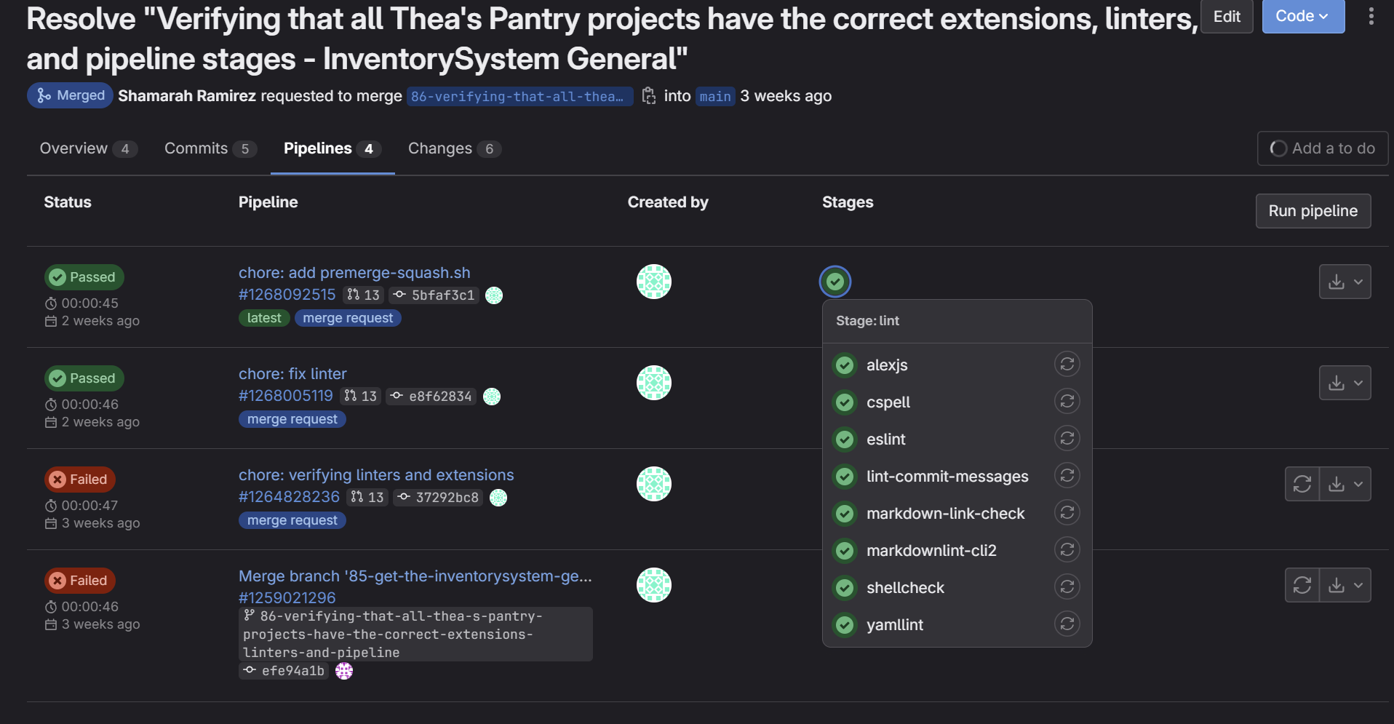

Slide 20
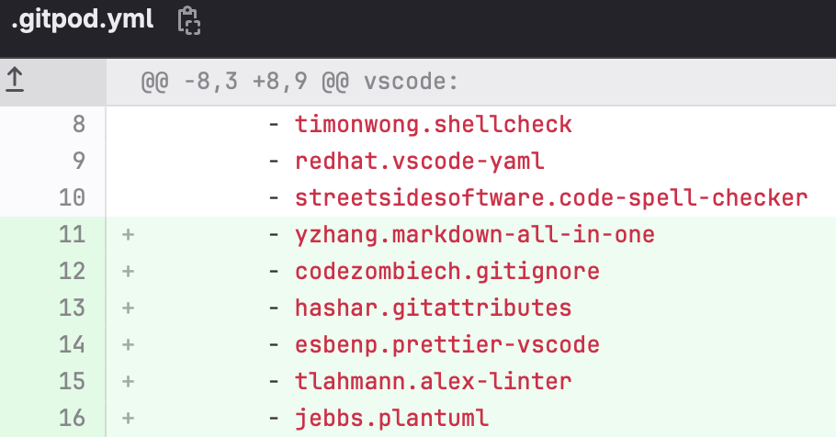
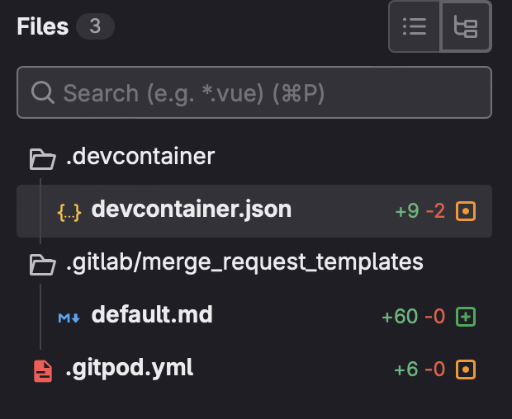
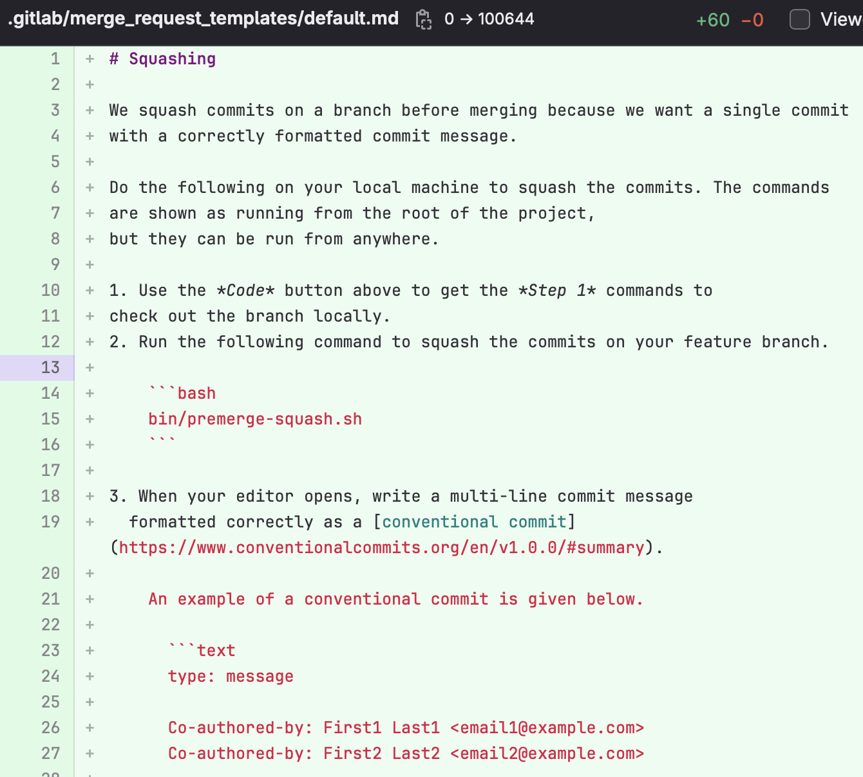
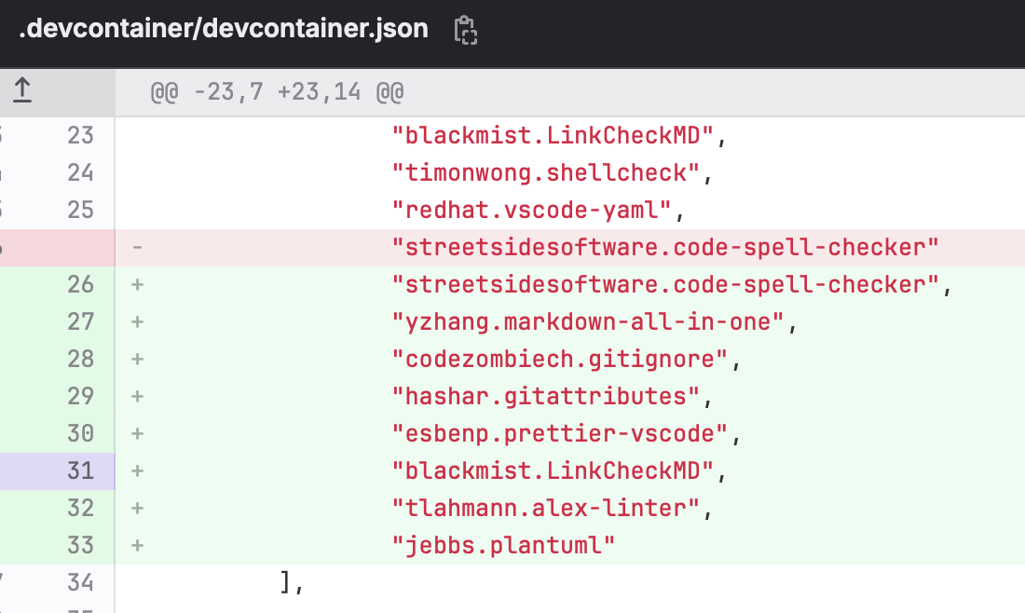
Update and Review Documentation
(InventorySystem/Documentation)
Notes:
Kaylene

Slide 21
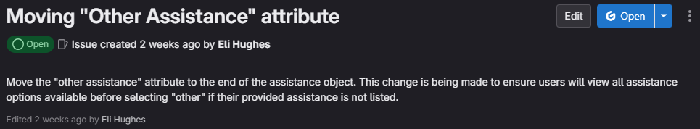

Determine what needs to be done for GuestInfoFrontend
Notes:
Eli

Slide 22
What went well?
Communication
Made sure that everyone understand their responsibilities and issues
Time management
Reviewing all of the issues
Made sure that issues were assigned equally
Notes:
Shamarah

Slide 23
Where to improve?
We could have improved upon our documentation of issues we completed
Have more clarity on who is the reviewer on each issue
Notes:
Ryan

Slide 24
What we learned this semester
This semester we learned more about theas pantry inventory system, guestinfo backend system, and the guestinfo frontend system
Verifying linters and extensions for the pipelines
How to work as a 5 person team, efficiently and effectively
Notes:
Kaylene

Slide 25
Focus areas for next semester
Add a sprint number tag in the scrum board to differentiate which sprint issues belong to which sprint
A better way to facilitate separation of work/set up a form of regular team to team communication
Upon reviewing GuestInfoFrontend we’ve learned that there are a couple of UI enhancements for students next year to work on
Notes:
Conner

Slide 26
Thank you!

